Slide 1
Automation flow
integration data from Zoho Books to Zoho CRM & Zoho Desk

Slide 2
GOAL -
Automated workflow so that product data get updated easily and fastly .
Products Data is already stored in the Zoho Books & CRM cloud Application. You will configure these applications in a way that Products data flows from Books to CRM then syncs with Desk vis-a-vis without manual import.

Slide 3
Implementation step 1
Integrate Zoho book with Zoho CRM -
Log in to Zoho Book website with Administrator privilege. Go to Settings > Integrations & Marketplace > Zoho Apps > Zoho CRM > Connect.

Slide 4
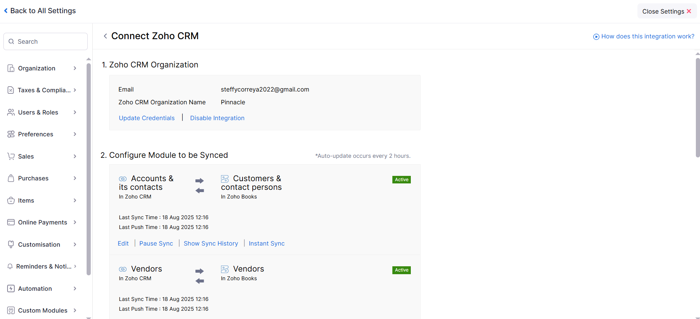

Slide 5
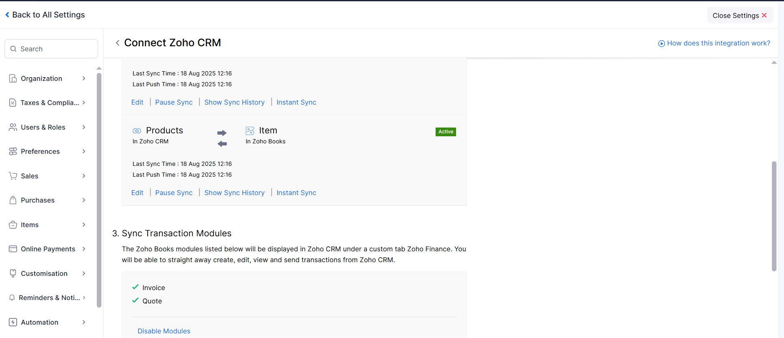

Slide 6
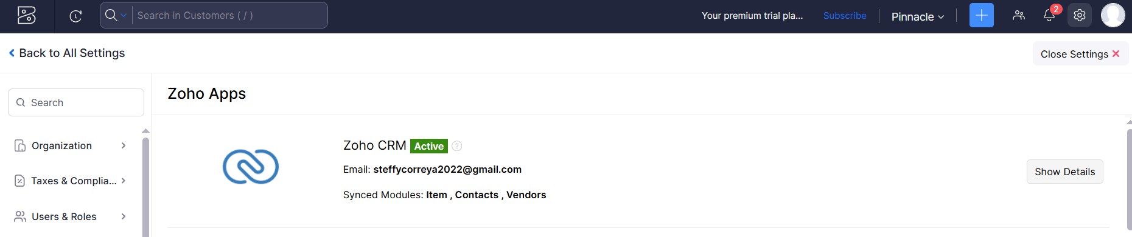
Successfully established with connection from Zoho book to CRM

Slide 7
Implementation Step 2 –
Integrate Zoho CRM with Zoho Books and Zoho Desk.
Login to Zoho CRM go to Settings > Marketplace > Zoho > Setup Zoho Desk & Zoho Finance suite (single platform for finance related services , it includes Zoho Books) .

Slide 8
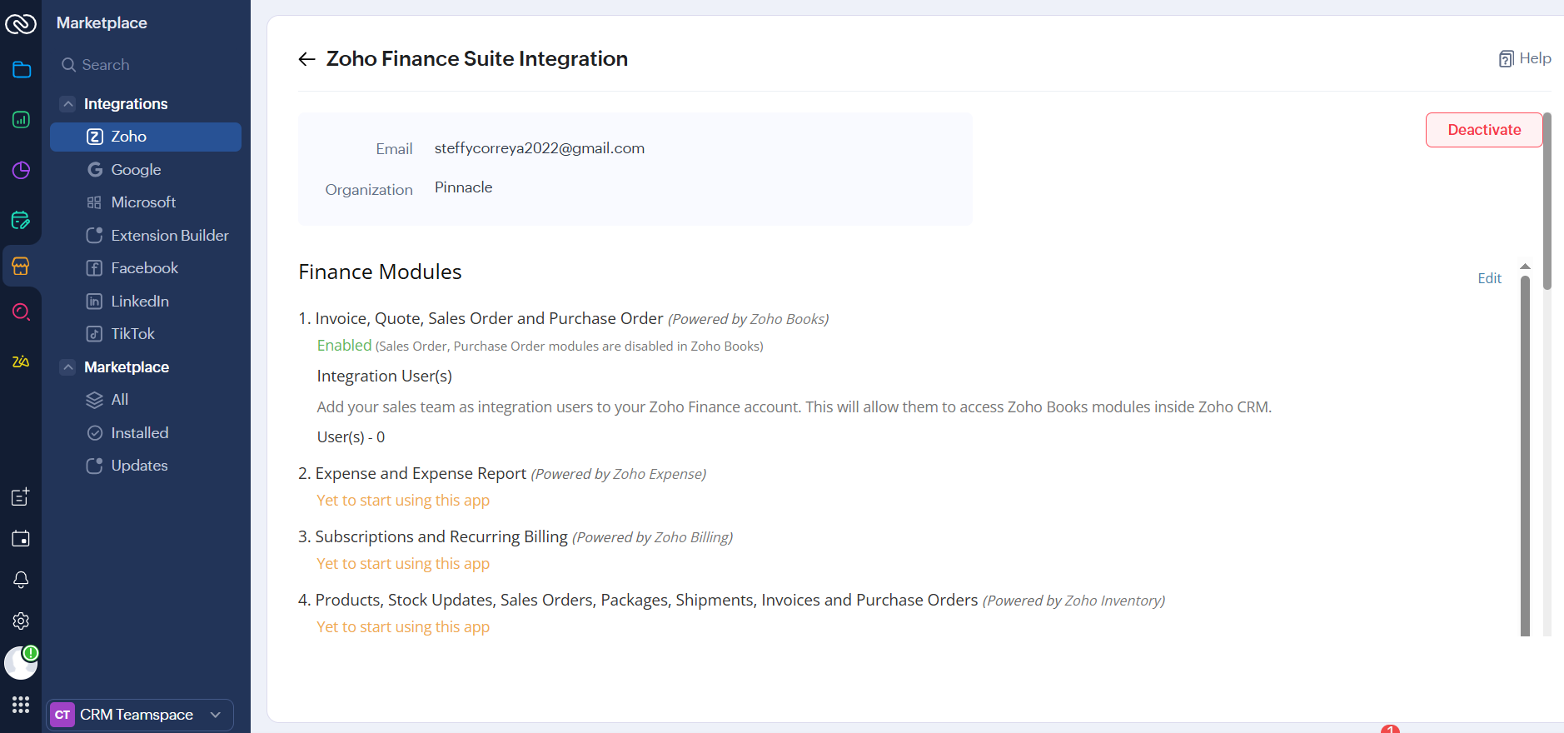

Slide 9
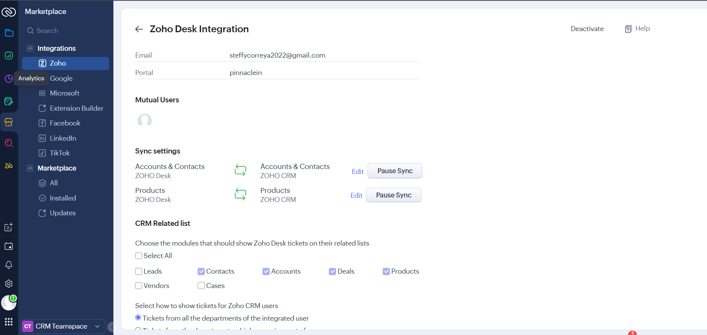
Successfully established connect with Zoho Desk & Books from Zoho CRM.

Slide 10
Implementation Step 3 -
Integrate Zoho Desk with Zoho CRM
Login to Zoho Desk with administrative privilage , Go to Settings > Integrations > Zoho > Zoho CRM .

Slide 11
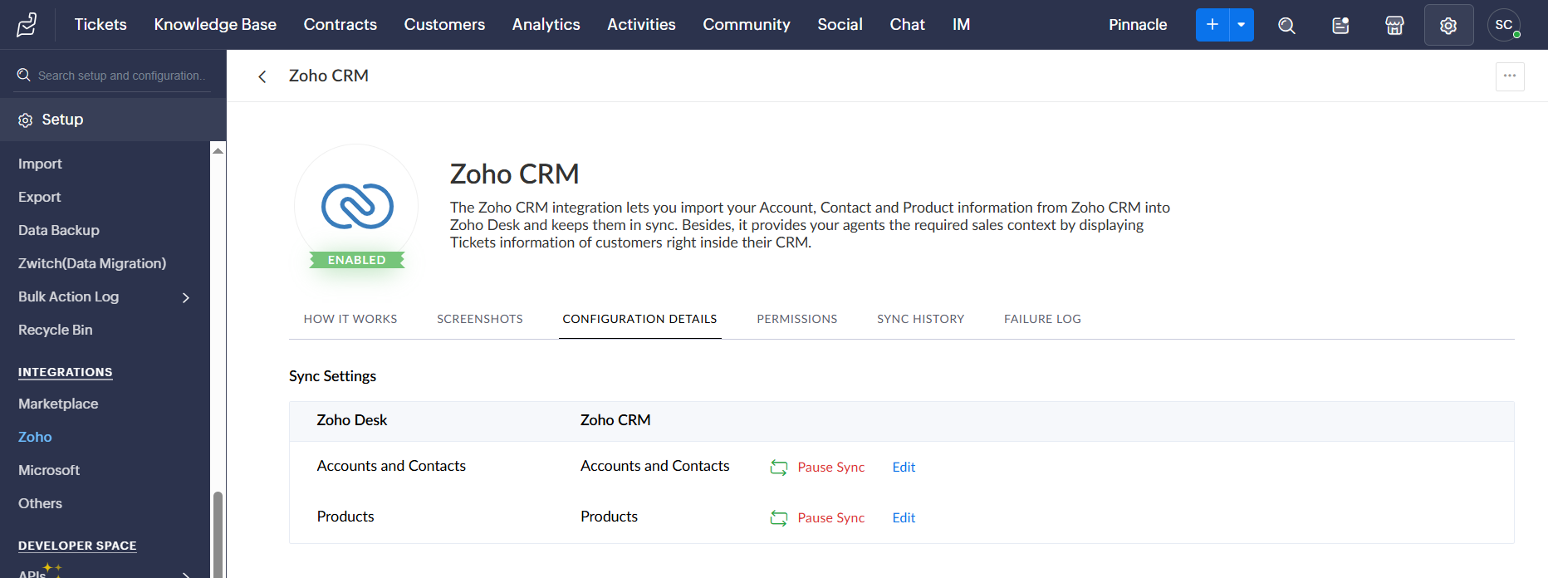

Slide 12
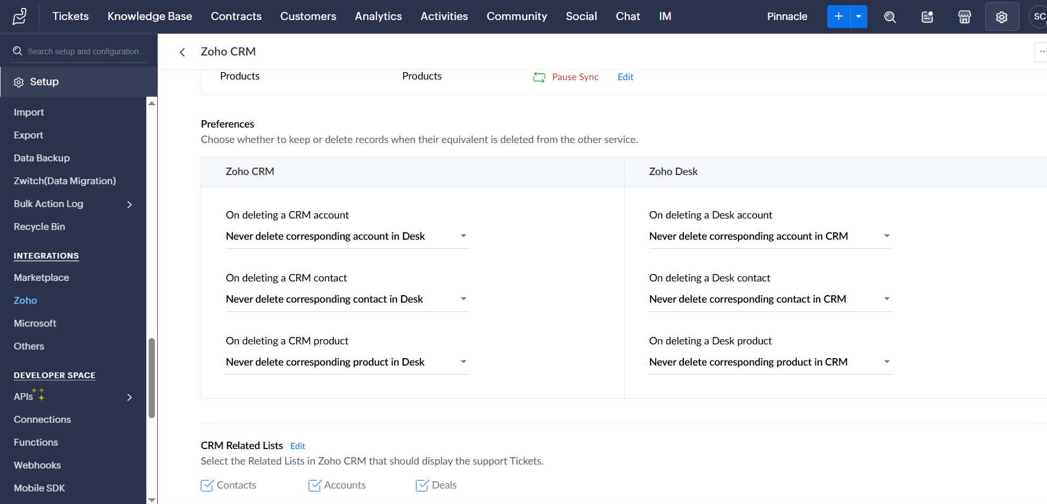
Successfully Established connect with Zoho CRM from zoho desk.

Slide 13
Result -
When new Item or Product get added in Zoho Book, same item details get updated over Zoho CRM & Zoho Desk automatically without manual effort .
The Schedule runs every 2 hours , So without missing any data gets updated every new entries .
Also existing entries has been already updated while established the connections.
Go to Zoho Books > Item > Create new Item > Save

Slide 14
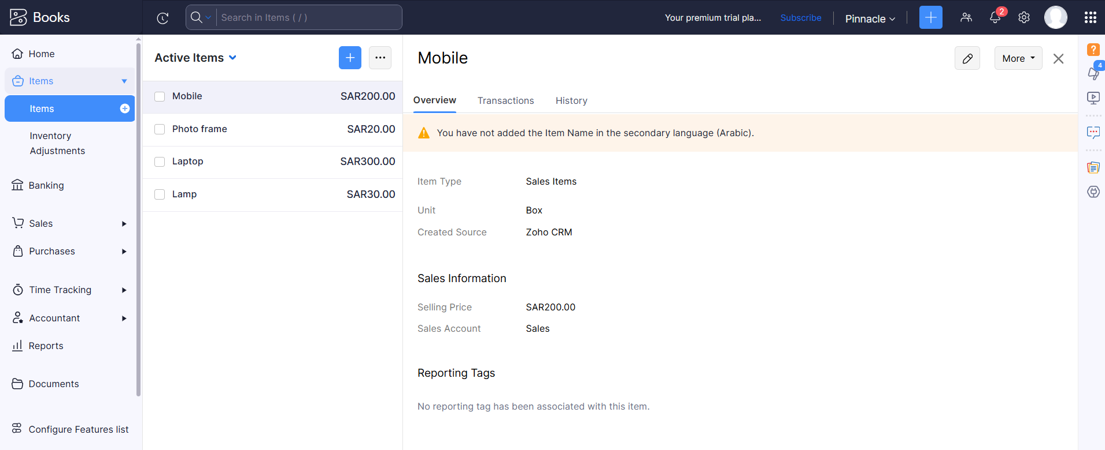

Slide 15
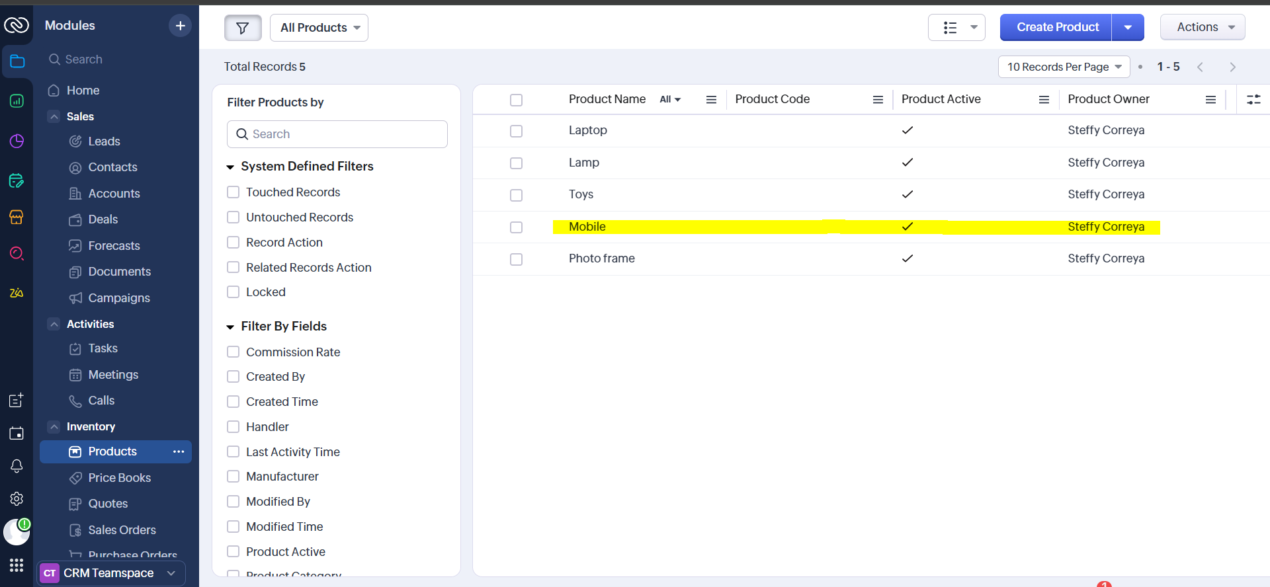
Login to Zoho CRM > modules > Products

Slide 16
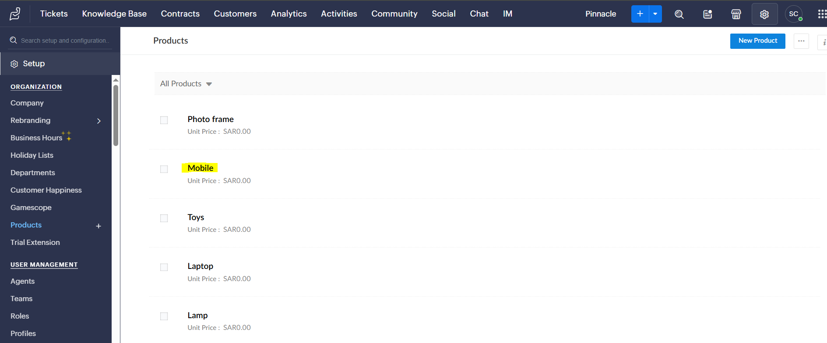
Login to Zoho Desk > Setup > Organization > Products

